Slide 1

Predictive Movie Analysis
By Taylor J. Simpson

Slide 2

-Andrei Tarkovsky
“Cinema is Sculpting in Time ”
Notes:
Fave book that’s not too pretentious, art form that you can walk mile, crafts people dedicated to common purpose, and when done right provide entertainment and education via storytelling

Slide 3
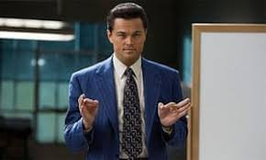
Agenda
-Intro
-Problem Statement
-Methodology
-EDA
-Modeling
-Linear
-Logistic
-Random Forest
-Analysis
-Next Steps
1

Slide 4
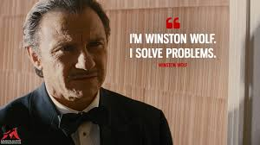
Problem Statement
What makes a film successful?
Different features
Evaluate using metrics

Slide 5
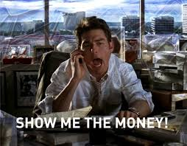
Revenue Analysis

Slide 6


METHODOLOGY
STEP 1
STEP 2
STEP 3
Data Acquisition
Data Cleaning
Modeling
Notes:
Just like Inception there are levels to this, couple of other options before MovieLens, offset of GroupLens of U Minn

Slide 7
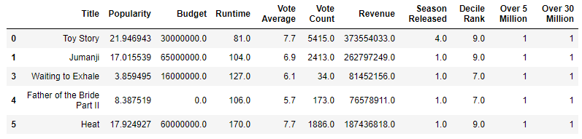
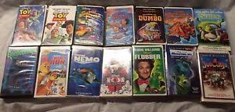
DATAFRAME
Notes:
Dataframe and what many 90s kids VHS collection looked like, numeric features,

Slide 8

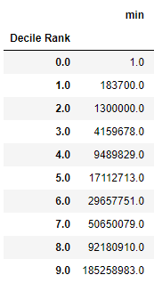
Exploratory Data Analysis
-Genres
-Deciles

Slide 9
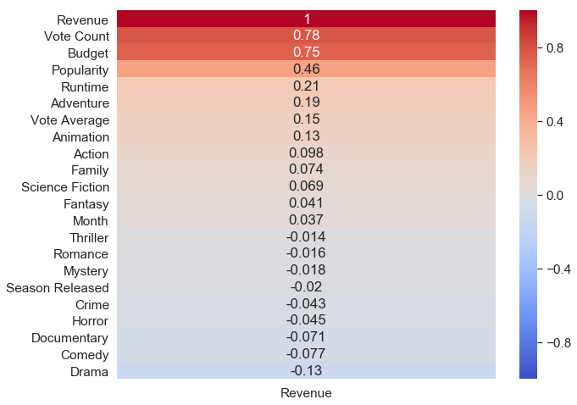

Exploratory Data Analysis
-Heatmap
Notes:
Genre distribution

Slide 10
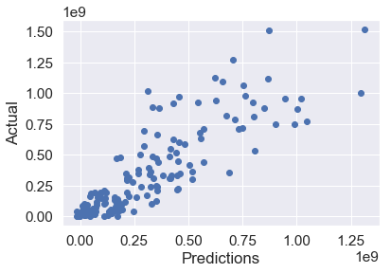

LINEAR REGRESSION MODEL

Slide 11
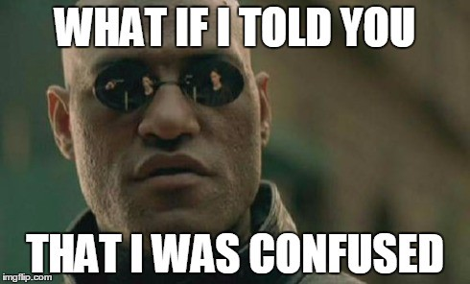
CONFUSION MATRIX
 | Negative | Positive
Negative | 31 | 530
Positive | 1 | 1236

Slide 12


LOGISTIC REGRESSION MODEL

Slide 13

CONFUSION MATRIX
 | Negative | Positive
Negative | 0 | 311
Positive | 0 | 1487

Slide 14

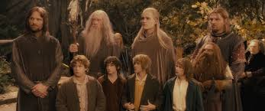
RANDOM FOREST MODEL
Notes:
Destroy the ring analogy -

Slide 15
CONFUSION MATRIX
 | Negative | Positive
Negative | 94 | 214
Positive | 47 | 1443
84% Test Score!

Slide 16
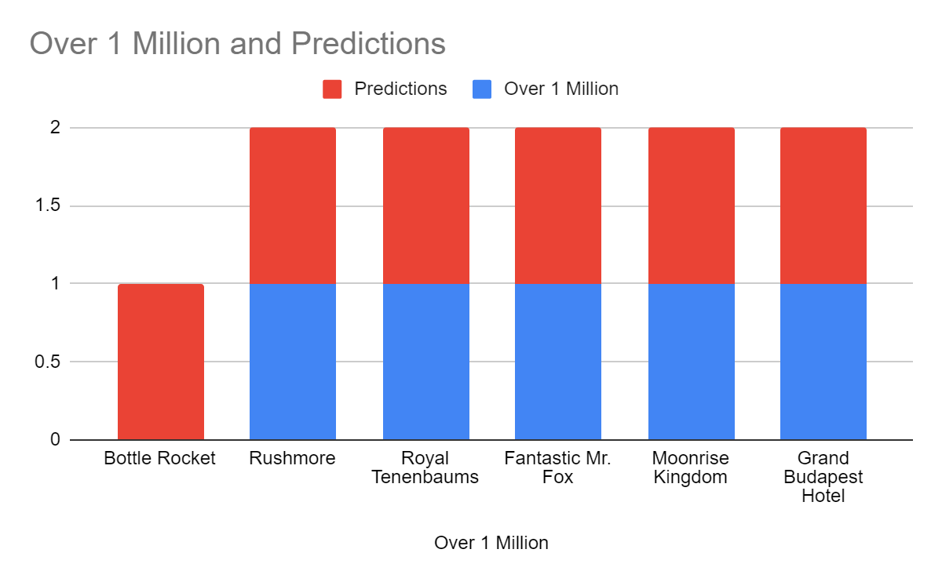

PREDICTIONS
83.3% Accuracy

Slide 17
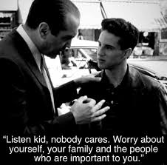
KEY TAKEAWAYS
Engagement matters!
An engaged audience is more likely to support movie and see it in theaters/digital purchase. Popularity and runtime.
Money Talks!
Takes money to make money, more budget correlates with more revenue
The crowds ARE wise!
83.3% accuracy with small sample size but with varied range

Slide 18

NEXT STEPS
More Data
Go back and supplement dataset with more features and star power quantification and critical consensus.
More Modeling
Genre Analysis and KNN
Even More Modeling!
Principle Component Analysis and Time Series

Slide 19

THANKS!
Any questions?
You can find me at
taylorjsimpson18@gmail.com

